Slide 1


PART I
Notes:
Hi and welcome to the Website PHH2.

Slide 2

Background
Fulfillment and production processes and standards have now stabilized
In the previous Power Half Hour we saw that:
YPG has a compelling story and a solid website portfolio.
Most Canadian businesses now have a website (more than 70%)
Now we need to be able to:
Approach clients who already have a website, make them realize they need a new one and that they need one from YPG
Position the importance of a good website with good content in order to rank well. With all the changes to search engines algorithms, SEO is no longer sufficient to ensure website prominence in organic search results.
Notes:
Let’s quickly review what we covered in the first Power Half Hour on Websites and take a look at what we will learn today
We saw in the previous Power Half Hour that
YPG has a compelling story and a solid website portfolio.
that more than 70% of businesses in Canada now have a website – this really changes the landscape in which we are operating.
Now, we need to be able
to approach clients who already have a website, make them realize they need a new one and that they need one from YPG.
Position the importance of a good website with good content in order to rank well. With all the changes to search engines algorithms, SEO is no longer sufficient to ensure website prominence in organic search results.
.

Slide 3





Agenda
In order to better prepare you to approach the client who already has a website, you need to be able to:
Understand why User Experience (UX) is important
Understand how SEO and UX interact
Explain what makes a good website
Understand and use the Website Analysis Grid
Position YPG website solution to clients with existing websites
Notes:
In order to better prepare you to approach clients who already have a website, we have developed this Power Half Hour to help you understand what makes a good (and a bad) website.
We will be talking about a the user experience of a website and why it has now become very important.
We will also see how user experience and SEO now have to work hand in hand.
And finally, we will give you tools to analyse websites, identify opportunities and convert these opportunities in new Sales.

Slide 4

Notes:
Let’s start by understanding what we mean by User Experience

Slide 5





















What is User Experience?
A great user experience means when someone visits your site they enjoy every portion of it. Great user experience also means they can maneuver around a site and find everything they’re looking for!
Simple
Consistent
Standard
Notes:
A user’s experience starts when they land on a page of your website. Ultimately, you want users to enjoy their visit to your site but you also want them to take action. A great user experience also means they can intuitively maneuver around a site and easily find everything they’re looking for!
A website will deliver a great user experience when has these three qualities: Simple, Consistent and Standard.
Remember - you want the user to spend minimal time figuring out how to find their way around your website and more time learning about why they should do business with you!

Slide 6



User Experience and SEO
UX
User experience focuses on user’s interactions, feelings, and opinions about your website. That being said, keeping users engaged depends on why and how they found your site.
SEO
SEO is highly focused on generating traffic for your website.
SEO is¸also concerned with quality content, page load times, and other tasks that affect the user experience (UX).
Your design might be genius, but it doesn’t matter if no one finds your website.
Notes:
In the past, SEO was enough to get you good ranking. With the recent changes to search engines algorithm such as Penguin and Hummingbird, it is not enough anymore. More than ever before, also need a good website with good content.
User experience and SEO work hand in hand - Your design might be genius, but it doesn’t matter if no one finds your website.

Slide 7


What to look for
when analysing a website
Engaging content and features
Quality of the content
Overall quality of the site
Mobile version
Ease of navigation
Elements built for trust
Visual hierarchy and presentation
Good usage of calls-to-actions
SEO Friendly
Notes:
As your website provider, YPG will partner with you to ensure that you get a good website built based on best practices and we will be there to update your site, the content or the platform whenever you need it or of there is change in the way people search and browse online.
You don’t know what to say about your business or how to say it? We’ve got your covered with professional copywriters
Worried about all the search engine algorithm changes? We’ve got you covered with regular website architecture updates
Can’t afford any surprises on your advertising budget? We’ve got you covered with all inclusive monthly billing
Want flexibility to promote new products or services or new locations? We’ve got you covered with included creative hours for regular updates to your content.
Poll
With all thoses advantage, do you think that our website solution offers a competitve price?
Yes
No

Slide 8


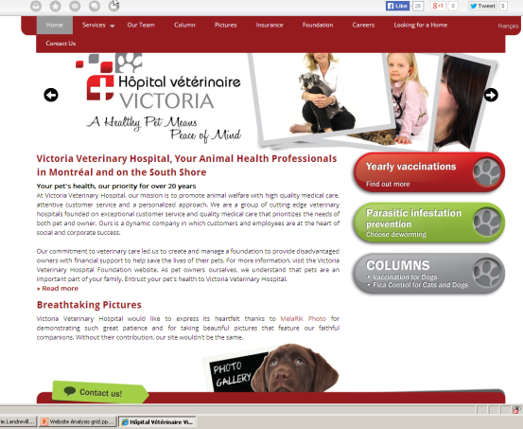



Overall quality of the site
Professionally designed and consistent throughout
It is easy to understand who the business is and what it offers
Images are relevant
and of good quality
There are no broken links
or errors on actions
The text format is consistent and easy to read
Notes:
The overall quality of a site is the first thing to look at. It refers to general feel of the site, its professionalism and simple things like: do you know at a glance what the business is about and what it has to offer.
Think of it as the first impression of your website.
For example - It is easy to know that this website is a family oriented veterinarian operating in the Victoria Region.

Slide 9

Visual hierarchy and presentation
Titles and headings
are prominent
Short sentences and paragraphs
Content is easy to scan
Content is not too cramped and is well spaced
Links stand out
Notes:
The second element - Visual Hierarchy and Presentation - speaks to the organization of the information and how easy it is to read through the content on each page
You have to quickly be able to recognize how the information is laid out and how you can find more information by clicking on links. You achieve that through well-organized pages and well-structured content.
Each page should have prominent titles, easy to see internal links, easy to use buttons to go to specific sections and enough text to give you the information you are looking for as well as enough space to keep everything readable.

Slide 10

Quality of the content
It is easy to find contact information
Content is fresh,
relevant and well written
Language is easy to understand
Focuses on visitor’s goals, pains and needs
Notes:
The third element is the quality of the content. Not only the quantity - although it is true that you need a minimum of content on your pages - but it is also about how well the content conveys your messages to the website visitor.
Does the content respond to their questions, problems or needs? If someone is searching for a transport driver course (like in this example), they want to know about tuition, if they qualify for the course, etc. , whether they can attend a virtual classroom. Make sure the content is focussed on your potential customer, not just a resume of how long you have been in business and how great your product is.
Also make sure that it is easy to contact you so that if they want to call you now, they don’t have to click on 5 pages to find your phone number.

Slide 11
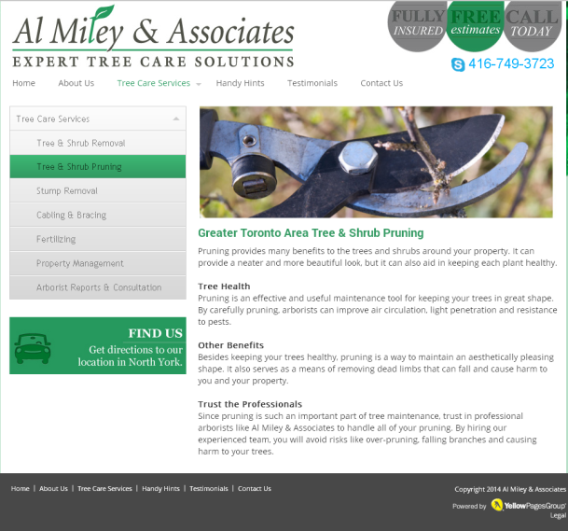
Ease of navigation
Facilitates common visitor tasks and search objectives
Navigation is clear and consistent on every page
Easy to navigate from one section to the other and back
Number of categories is appropriate
Notes:
The fourth element is the ease of navigation throughout your site – back and forth between pages. The information needs to be organized in subjects and sub-subjects. The navigation has to be structured and easy to understand. A navigation menu must be present on every page and allow visitors to easily go back and forth between the pages.

Slide 12

Elements built for trust
Pictures of the staff and office
Awards and accreditations
Includes testimonials
Notes:
The fifth element to look at is what elements are present to build trust. A good website should have pictures of the business and staff when relevant. Or a list of awards or accrediations.
In this example, you can see the dentist and the clinic and the qualifications. You get a good sense of their professionalism and it makes you want to go there.
In this case, the only thing the owner could do is also add testimonials from satisfied clients to confirm what he has already established. This just shows that even really good websites can always be improved…

Slide 13
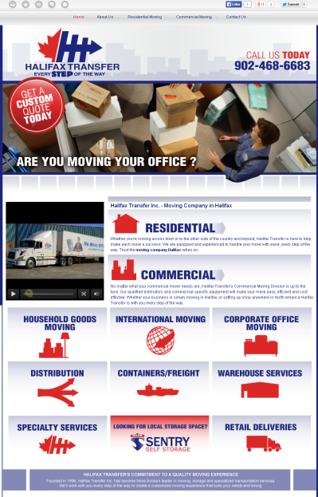
Engaging content and features
Social elements are integrated
to the site
Graphic & multimedia are related to the
content of the site
Interactive functionalities are
easy to use
Notes:
The sixth element is making sure your site is engaging and interactive. Visitors like demonstrations and like to have control. This website has a video and also big buttons at the bottom where visitors can click to find more information. The experience remains simple but also interactive and interesting.

Slide 14

Good use of calls-to-action
Present on every relevant page
Consistently placed and formatted
Action-oriented (i.e. download our catalogue vs. click here)
Notes:
Seventh - Good use of calls to action is key to website success. You can have the most appealing website with the best content but if you can’t convert your visitors into buyers, your website won’t bring you any return on investment.
This child care website is a really good example of well-used calls to actions. They are consistent and action oriented i.e. enroll your child today.
Calls to action should be present on every page!

Slide 15

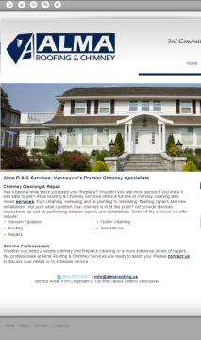
Mobile version
A mobile version
of the site exists
It is easy to navigate the mobile version
The mobile version is focused on
click to action
Notes:
Eighth - A good mobile version is one that was developed expressly for the mobile users. It doesn’t just mean being able to access a website on a mobile device. You can do that with any website – but if it’s not optimized for mobile it will be very difficult or impossible to see or navigate.
Having a mobile version of your website means it is designed to be easy to navigate on a smartphone and is focused on clicks-to-action. Mobile users need to find what they are looking for quickly and easily.

Slide 16
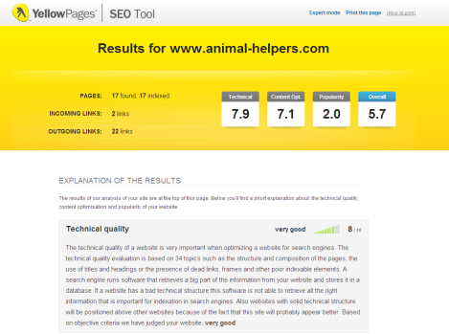
SEO friendly
All pages are properly tagged
All titles are properly tagged
All images are properly tagged
No duplication of content within the site or on any other website
Site loads quickly (3 seconds or less)
Short and meaningful URLs which represent the page topic
You can also use the SEO tool to get a more in-depth analysis
Notes:
And last but not least – a good website is SEO friendly. In other words it is designed to be easily read by search engines
You can use the SEO tool to get a more in-depth anaylsis of the opportunties for improvement to a website’s SEO.
Don’t forget! A good website is not only one that is SEO friendly or even SEO optimized. It is the combination of SEO and User Experience that makes a website solution a good one as we saw earlier…

Slide 17




Poll
What tools do you have access to that can analyse how good a Website is? (choose all that apply)
YPG SEO tool
BDC website analysis tool
My PMA
I don’t know of any
Notes:
Many tools are available to analyse SEO factors as they are technical components that are easy to assess.
User expererience cannot be assessed through a tool. Only a human can spend time looking at all elements of a website and evaluate how easy or difficult is is to navigate, whether or not it gives him what he is looking for, judge if the business is credible, etc.

Slide 18


Introducing the Website Analysis Grid
We have developed a grid to help you remember what to look for when analysing a website.
It was developed using Powerful SEO and User Experience tools and metrics.
Notes:
After seeing all the elements that make a good website, we developed this simplified user-friendly tool based on the Website Analysis tool used by Mediative to assess a website.
You will find every category we just reviewed in this Grid. And a place to check off the elements that you find for your advertiser’s website

Slide 19
Using the Website Analysis Grid
Why should I use the grid?
To help you identify opportunities for improvements on any website
To learn what to look for when analysing a website
To document what you would like to point out to your customer
What should I use it for?
To demonstrate opportunities to improve their current website and to demonstrate your professionalism
For YPG website renewals
For YPG Website upgrades
For advertiser with a non-YPG website (good or bad website)
What about advertisers who have a good website?
Notes:
So why should I use the Grid?
To help you identify opportunities for improvements on any website
To learn what to look for when analysing a website
To document what you would like to point out to your customer
What should I use it for?
To demonstrate opportunities to improve their current website and to demonstrate your professionalism
For YPG website renewals
For YPG Website upgrades
For advertiser with a non-YPG website (good or bad website)
So why should you present the Grid to someone with a good website?
Show professionalism ex. dentist site with testimonial missing
Cross-sell SEO or SEM
Maybe client is not happy with current supplier
Opportunity to add a video

Slide 20

Upsell – Advertisers with YPG Websites
Identify all your clients with a WebStart and demonstrate the need to upgrade to a WebPro
Identify your clients interested in an enhanced design and upgrade them to a WebMax
More Content is King
Use the Website Gallery
Before and after examples
Identify your clients who could need a second website
Identify your clients who don’t have a website and offer them a WebPro (or a WebPro Booster)
One business with different lines of services
(careful, the company has to have two different business names, address or phone numbers to ensure there is no impact on SEO).
Notes:
Let’s take a closer look at upsells:
The Grid can be used to support various types of upsell scenarios.
1-Identify all your clients with a WebStart and demonstrate the need to upgrade to a WebPro
2- Identify your clients interested in an enhanced design and upgrade them to a WebMax
3-Identify your clients who could need a second website
4 – Identify clients without a Website and offer them a WebPro (or a WebPro Booster)
Video

Slide 21






Outsell – How to sell a website to someone who has one
Demonstrate that YPG is the right supplier (show all inclusive slide and examples)
Find out if he measures traffic and interactions?
Ask your client if he makes changes and if he is satisfied with his current supplier
Use the grid to prepare the account
Recommend the best solution
Discuss website opportunities with YPG
Find out why he created a website in the first place (generate traffic, branding) and is it working?
Start by asking your client what he likes or dislikes about his site
Notes:
Let’s look at advertisers who already have a website with someone else:
After going through the Grid, here are the steps that you can take to approach a customer who already has a website.
By doing your preparation, you will have identified areas of improvements already and will be able to consult your client about how YPG can help.
You might not need to go through all these steps and some might work better in a situation or another. Find what works for you but the important thing is : Don’t be afraid to offer a website to someone who has a website – even if they think it is a good one!

Slide 22
Recap
Both user experience and SEO are important for a good website
Nine elements of a good website user experience
New tool to evaluate a good website user experience
New tool to support:
Upsell
Outsell
Cross-sell
Notes:
We just saw what the elements of a good website are and how to analyse a website for opportunities to improve it.
We also looked at How to use the Grid,
How to use the Grid to support an Upsell proposal
How to approach proposing a YPG website solution to someone who already has a website.
As well as how to promote traffic to a website with pllcement and SEM and SEO solutions
You are now equipped to sell YPG website solutions to anyone.
So let’s pause here and let’s Go Sell!
We will talk to you soon for the PHH part 3.

